Slide 1
Patient Diagnosis with Machine Learning
Caitlin Ortega Ruble

Slide 2

How diagnosis is done
Data: Symptoms, Test Results, Etc.
Diagnosis
Treatment
Doctor's Knowledge
Notes:
Tell story of the sick Dodo bird
Bird goes to doctor, that doctor uses two things (CLICK):
Data about symptoms, lab results, family history, etc + their knowledge to come up with…(CLICK)
A diagnosis. (CLICK)
That diagnosis leads to treatment, which, hopefully resolves the illness so our Dodo bird can feel better and get on with its life

Slide 3

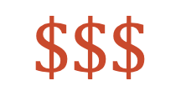
How can it go wrong?
Prolonged Suffering
Data: Symptoms, Test Results, Etc.
$$Σ$$
Diagnosis
Mis-diagnosis
Treatment
Wrong Treatment
$$\$\$\$$$
Doctor's Knowledge
Doctor's Knowledge
Severe Illness and Death
Notes:
We all know doctors are very smart people. They study for years to memorize vast quantities of medical data, gain first hand experience practicing medical theory with patients and continue to gain experience through their years of practicing medicine.
However, they are also people, and not walking encyclopedias of medical knowledge. They are subject to the fallibilities of being human.
So let’s say that there is a flaw or gap in a doctor’s knowledge or reasoning. (CLICK)
And let’s say this gap leads to a misdiagnosis for the patient. (CLICK)
Which in turn leads to the wrong treatment. (CLICK)
At best, this leads to prolonged suffering (CLICK)
At worst, this leads to severe illness and even death
And the Sum of all this is suffering and a lot of money (CLICK)

Slide 4
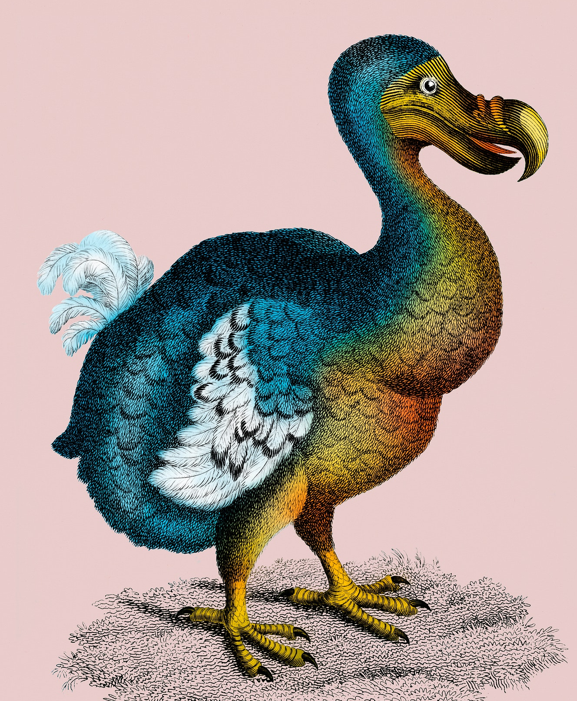
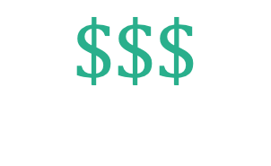
What can we do?
Data: Symptoms, Test Results, Etc.
$$\$\$\$$$
Right Diagnosis
Mis-diagnosis
Right Treatment
Wrong Treatment
Doctor's Knowledge
Machine Learning Model
Notes:
SO, what can we do?
Well, my proposal is to replace that error-prone doctor knowledge component with a machine learning model (CLICK)
That takes that symptom data and gives (CLICK) the right diagnosis
In turn leading to the (CLICK) right treatment
Which saves a lot of money(CLICK), a lot of suffering, and, of course (CLICK) healthy patients with better outcomes.

Slide 5
The data: "Disease Prediction Using Machine Learning" from Kaggle
Data:
- 4920 patient observations
- 131 symptoms
- 41 diseases

Slide 6
Some light tidying to get the data ready for analysis and modeling
Data Handling
Duplicate Features
Formatting
Label Encoding
One symptom had two associated columns with nearly identical names
One column was empty
Empty column dropped, other column renamed
Several disease names had simple misspellings
Replaced with correct
Some disease names had inconsistent formatting
Capitalized first letter
Disease names were label encoded prior to modeling

Slide 7
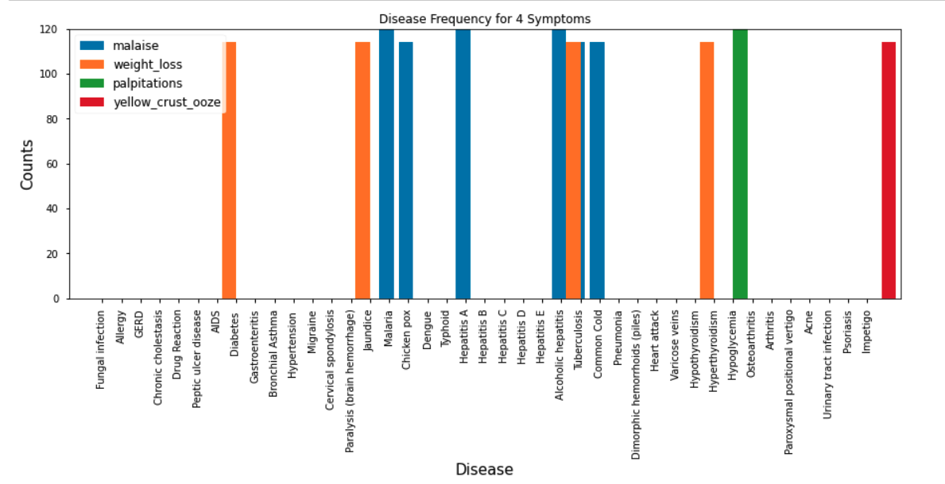
Symptoms can be indicated in one or more diseases
Notes:
(See ‘yellow_crust_ooze’) Some symptoms were only indicated in 1 disease prognosis.
(See ‘palpitations’) Some symptoms were only indicated in 1 disease prognosis and are indicated in every instance of that prognosis in the training set.
(see ‘weight_loss’) Some symptoms were indicated in more than one prognosis.
(see ‘malaise’) Some symptoms were indicated in more than one prognosis and were always indicated in one or more of the possibilities.

Slide 8
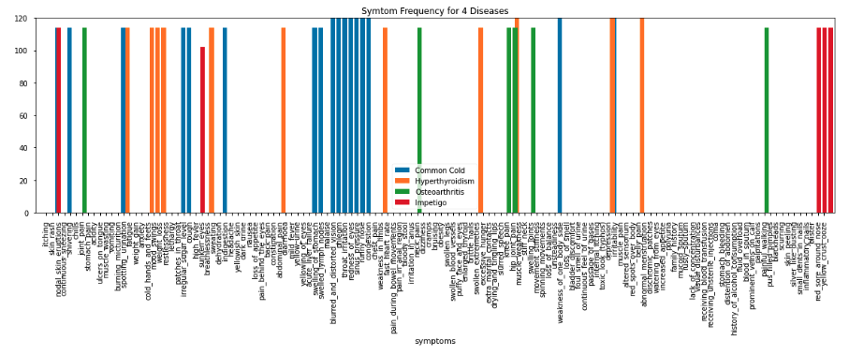
Each disease has a unique combination of symptoms

Slide 9
7 classification models were tested and 4 had perfect test accuracy scores
AdaBoost
AdaBoost
Random Forest
Accuracy: 0.99 F1: 0.99
Precision: 0.99 Recall: 0.99
Gradient Boosting
Accuracy: 1.0
F1: 1.0
Precision: 1.0
Recall: 1.0
Accuracy: 1.0
F1: 1.0
Precision: 1.0
Recall: 1.0
Disease Classification
(80/20 Train/Test Split)
SVC
XGBoost
Decision Tree
Decision Tree
Accuracy: 1.0
F1: 1.0
Precision: 1.0
Recall: 1.0
Accuracy: 1.0
F1: 1.0
Precision: 1.0
Recall: 1.0
Entropy
Entropy
Gini Impurity
Gini Impurity
Accuracy: 0.95 F1: 0.95
Precision: 0.96 Recall: 0.96
Accuracy: 0.95 F1: 0.95
Precision: 0.96 Recall: 0.95
Notes:
Next, we reserved 20% of the data for testing, and fit the remaining 80% of the data to 7 different classification models.
First, a decision tree (CLICK 1),
which we actually used twice with two different loss functions (CLICK 2)
First was an entropy-based model (CLICK 3), which scored at 95% accuracy on the test set. You can read the rest of the test scores here, too.
Next was a gini-impurity based model (CLICK 4), which scored identically to the entropy based tree except with a slight loss in recall on the test set.
We tried an Ada Boost classifier, which scored 99% on accuracy, F1, precision and recall.(CLICK 5)
Next a Random Forest (CLICK6), which scored a perfect 1.0 on our performance measures.
A support vector classifier (CLICK7) also had perfect metrics.
We tried a Gradient Boosting model (CLICK8), which scored perfectly on the test set.
And lastly we tried an XGBoost model (CLICK9), which once again yielded perfect test scores.
So this gave us a total of 4 different models that performed equally well. (CLICK 10).
These results gave rise to two new questions:
The first: 100% accuracy seems too good to be true—how do we know these models are valid?
The second: with equal performance, how can we differentiate which model to proceed with in a production setting? I’m going to tackle the latter first, and then address the former.

Slide 10
Training time and prediction time per patient to differentiate models
AdaBoost
Random Forest
Gradient Boosting
Training: 0.6s
Training: 39s
Prediction : 0.04ms
Prediction : 0.06ms
Disease Classification
(80/20 Train/Test Split)
SVC
XGBoost
Decision Tree
Training: 0.6s
Training: 22s
Prediction : 0.09ms
Prediction : 0.02ms
Entropy
Gini Impurity
Notes:
So we measured the amount of time it took to train the top models on training data and the time it took to predict the diagnosis of one individual patient sample.
Here are the training time results. (CLICK) The Random Forest and SVC models took just 0.6s to fit to our training data. the Gradient Boosting model took 65x that amount of time, and XGBoost took 37x that amount time. Now, training time may or may not be important in a production setting. We likely would be retraining the model in batches in order to maintain good control over the medical diagnostic tool, so retraining would be a periodic task rather than a constant one. However, as the dataset scales, the disparities in training time could still make a big difference in time and computing resources.
We were also interested in how quickly

